Slide 1
Structural Sizing of an Aircraft Wing Structure
MECH5930 Term-Project Proposal Presentation
Alfiyandy Hariansyah (21023691)
mahariansyah@connect.ust.hk
6-Nov-2025
THE HONG KONG UNIVERSITY OF SCIENCE AND TECHNOLOGY
DEPARTMENT OF MECHANICAL AND AEROSPACE ENGINEERING

Slide 2
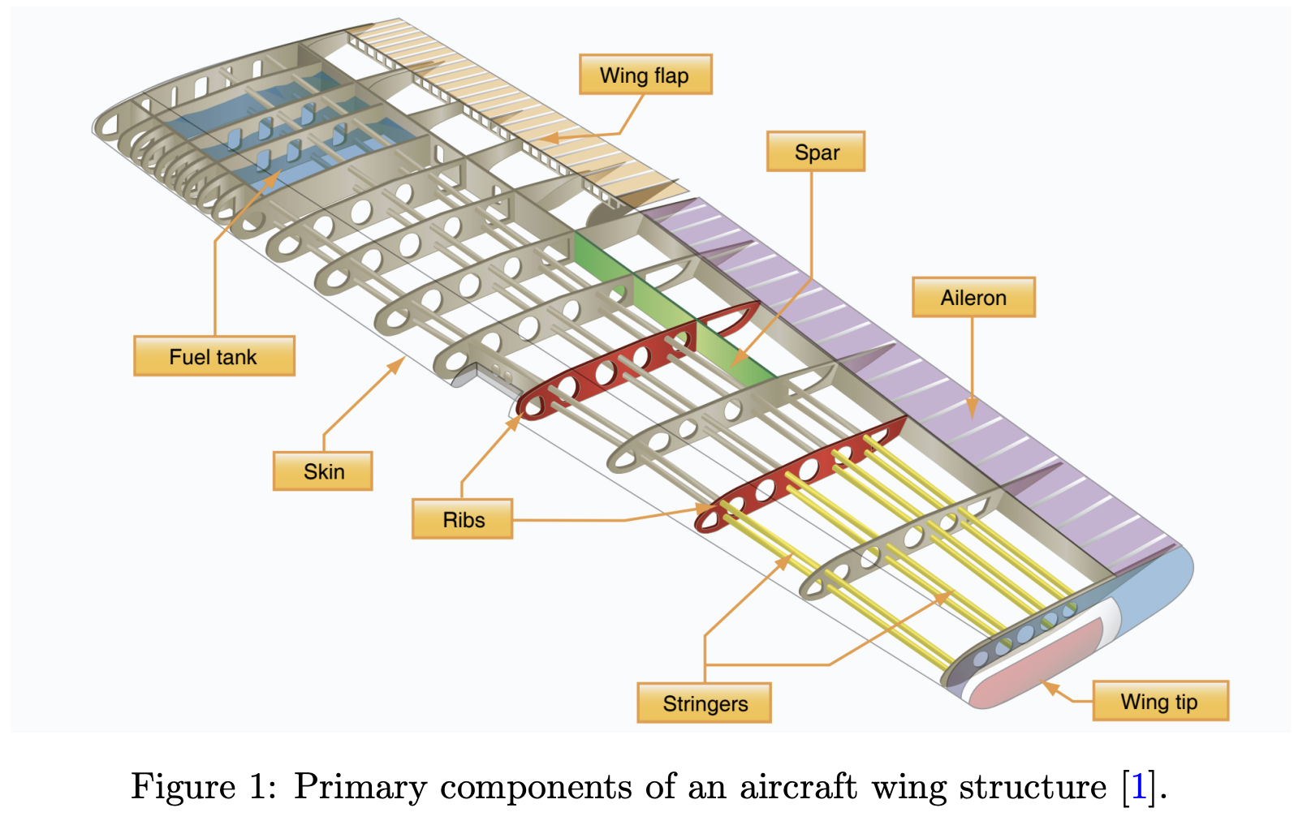
Introduction: aircraft wing structure
An aircraft wing structure must withstand various loads:
Aerodynamics
Self-weight
Operational loads (gust, maneuver, etc.)
Main components:
Outer skin: transfer aero load
Spars: resist bending and shear
Ribs: maintain airfoil shapes
Stringers: handle torsions

Slide 3
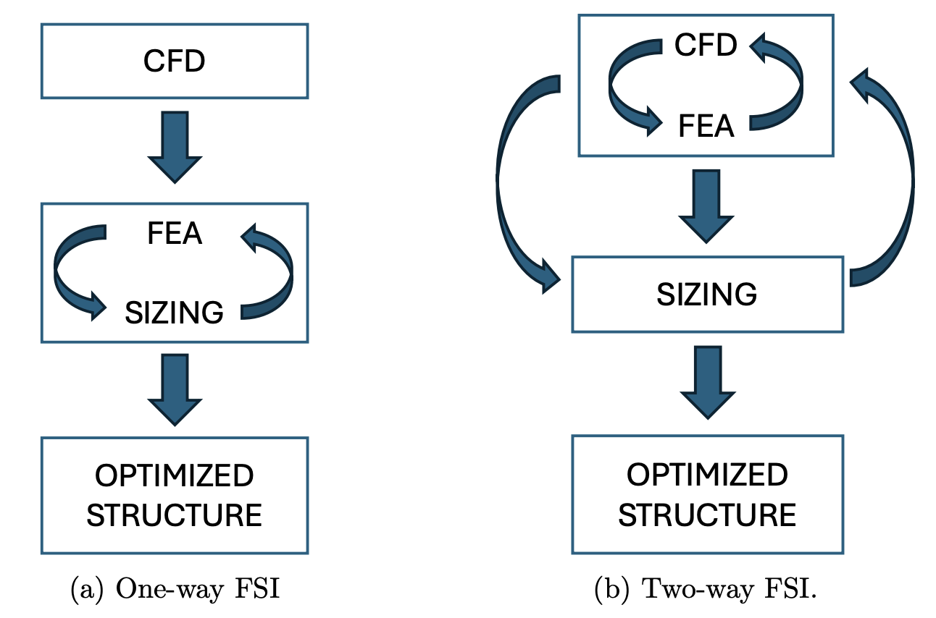
Introduction: structural sizing
Structural sizing: an optimization process determining the optimal dimensions for the structures (e.g., skin thickness, spar cross-sections, rib placement)
FSI: fluid structure interaction
One-way FSI: FEA and CFD are not coupled, sizing iteration is only with FEA
Two-way FSI: FEA and CFD are coupled, sizing iteration is with both CFD and FEA

Slide 4
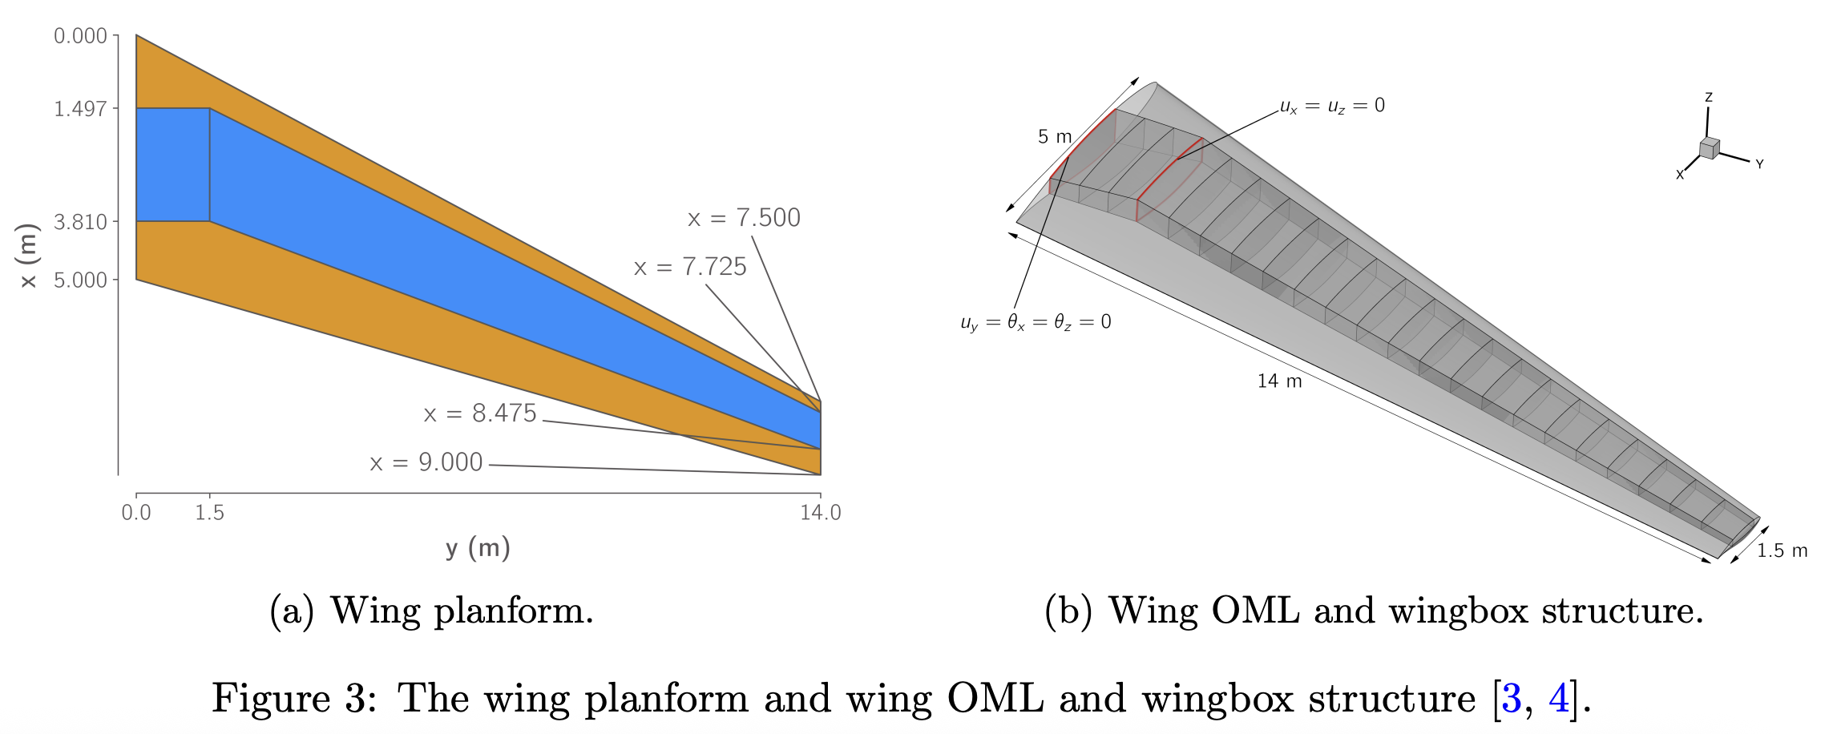
Problem description
The wing geometry has not been finalized. The following is just for illustration purposes (from MDO Benchmark case, based on Boeing 717 wings). Only skins, ribs, and spars will be modelled. Stringers are not modelled.

Slide 5
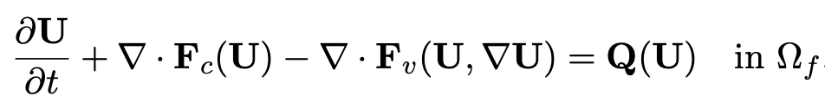
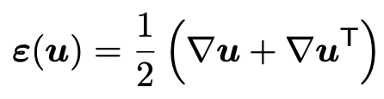
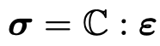
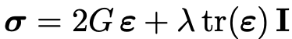
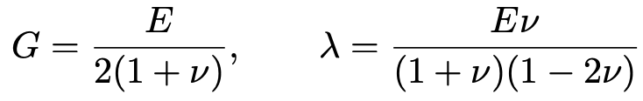
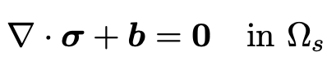
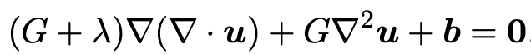
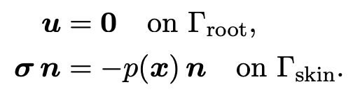
Governing Equations and Boundary Conditions
FEA: Linear Elasticity
CFD: Compressible Navier-Stokes
Reynolds-Averaged Navier Stokes
Boundary Conditions
Fixed support at wing root, and pressure from CFD, p(x), is applied to the wing skin.

Slide 6
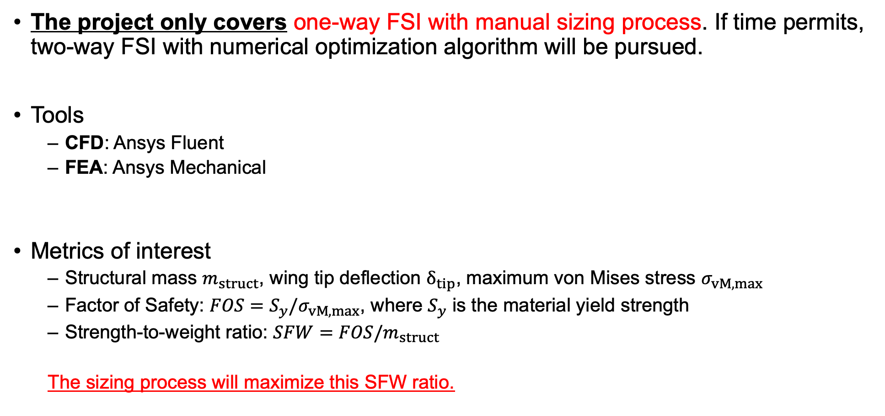
Proposed plans
The project only covers one-way FSI with manual sizing process. If time permits, two-way FSI with numerical optimization algorithm will be pursued.
Tools
CFD: Ansys Fluent
FEA: Ansys Mechanical
Metrics of interest
Structural mass $m_{struct}$, wing tip deflection $δ_{tip}$, maximum von Mises stress $σ_{vM,max}$
Factor of Safety: $FOS=S_{y}/σ_{vM,max}$, where $S_{y}$ is the material yield strength
Strength-to-weight ratio: $SFW=FOS/m_{struct}$
The sizing process will maximize this SFW ratio.
Assumptions
Load case: only one design condition, i.e., at cruise flight condition
Element types: SHELL181 (4-node, linear) or SHELL281 (8-node-quadratic)
Materials: aerospace-grade aluminum alloy

Slide 7
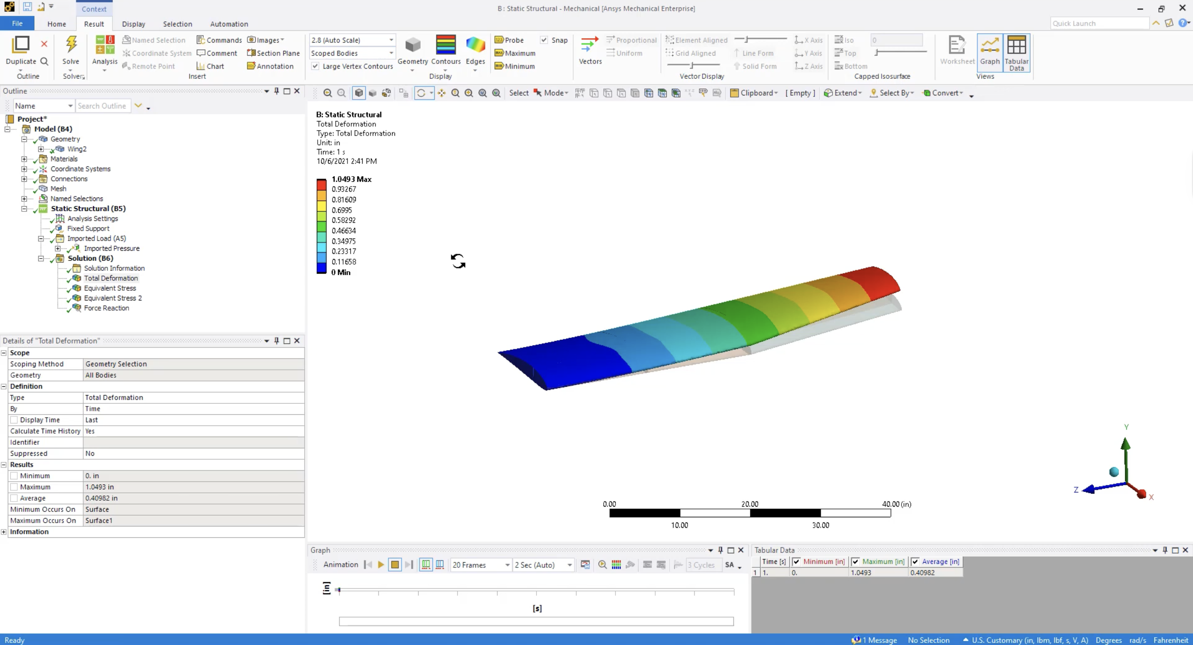
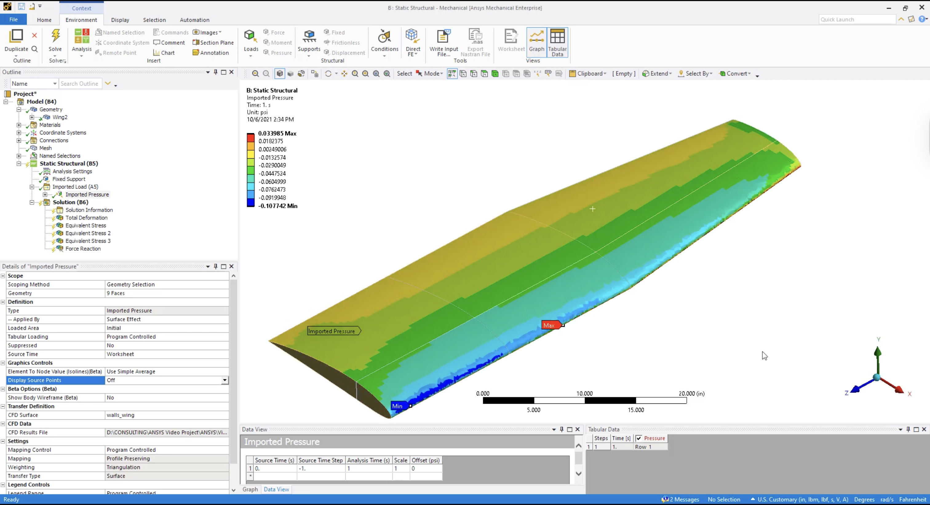
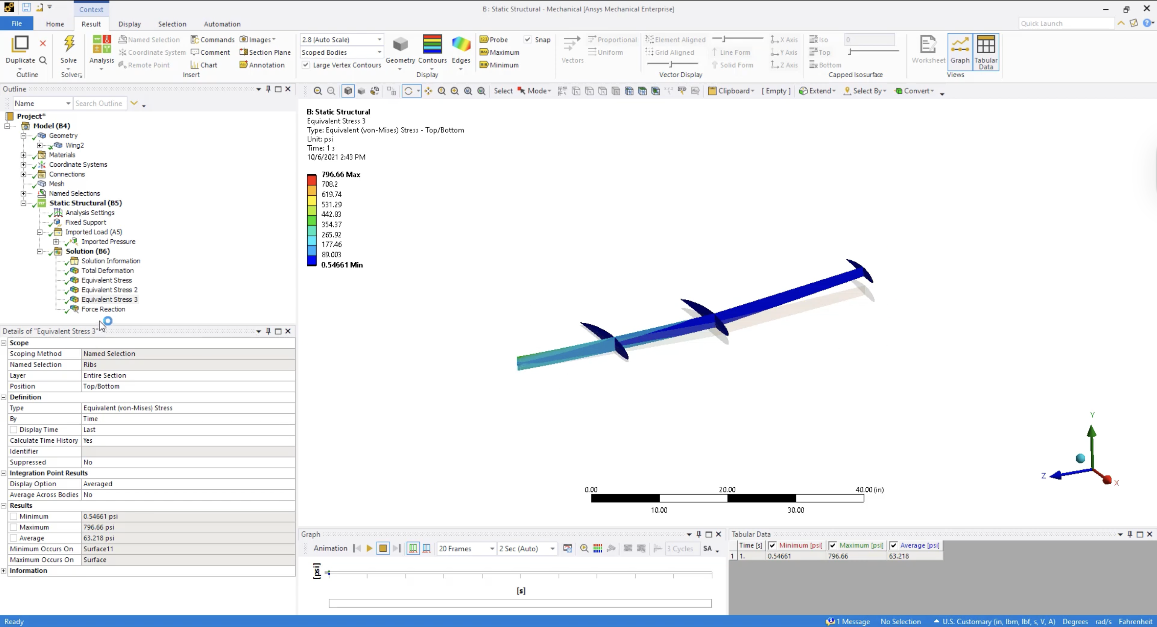
Tutorials from Ansys
2
1
3
Pressure loads imported from CFD
Wing deflection
Von Mises stress on the spar and ribs
https://www.youtube.com/watch?v=yiTA2AiswEQ

